Slide 1
Java Method References - Referring non-static methods
Like static methods, We can refer instance methods also. Below is the syntax.
containingObject::instanceMethodName

Slide 2
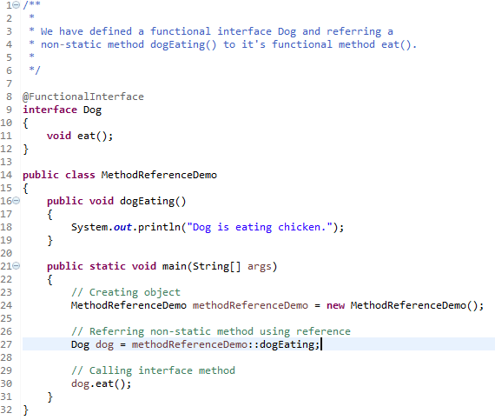
Java Method References - Referring non-static methods
Referring

